Slide 1
Speed Camera Investigation (Analysing)
Teacher guidance
This resource encourages students to analyse the effectiveness of speed cameras. Students will study maps looking for patterns and analyse
graphs in order to draw conclusions. It is advised that teachers do this module to introduce students to the Speed Camera Investigation topic.
The maps and spreadsheet with data can all be accessed online to allow students to investigate individual areas should they wish.
There are no exact solutions as such, although students should arrive at some of these conclusions:
● 50+mph speed limits are distributed on the main A road networks leading out of Central London.
● The centre of London is predominantly 20 and 30 mph zones.
● More fatal collisions occur on the A roads with higher speed limits.
● There are more total collisions at speed camera points in Central London than on the outskirts.
● Total collisions are generally decreasing in London year on year.
Google Maps
● Sorted by speed limit
● Sorted by fatal collisions
● Sorted by total collisions
Link to Google Spreadsheet of collision data​ (in File menu, you can download as an Excel file)

Slide 2
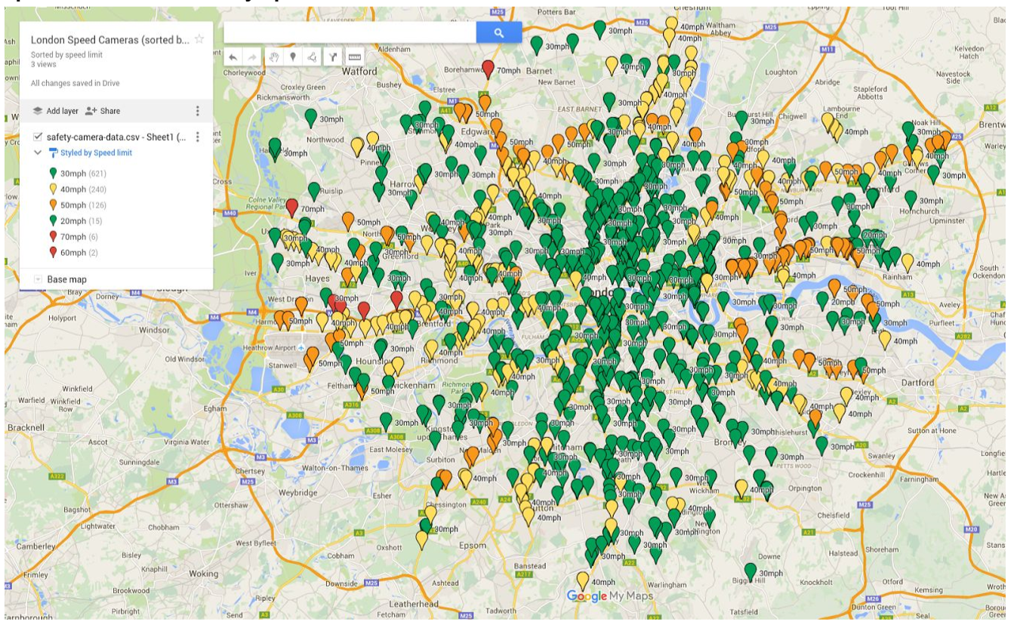
Speed Camera Investigation (Analysing)
How effective are speed cameras
Speed Cameras sorted by speed limit
Describe the pattern and distribution of speed cameras around London.
Why do you think it might be like this?

Slide 3
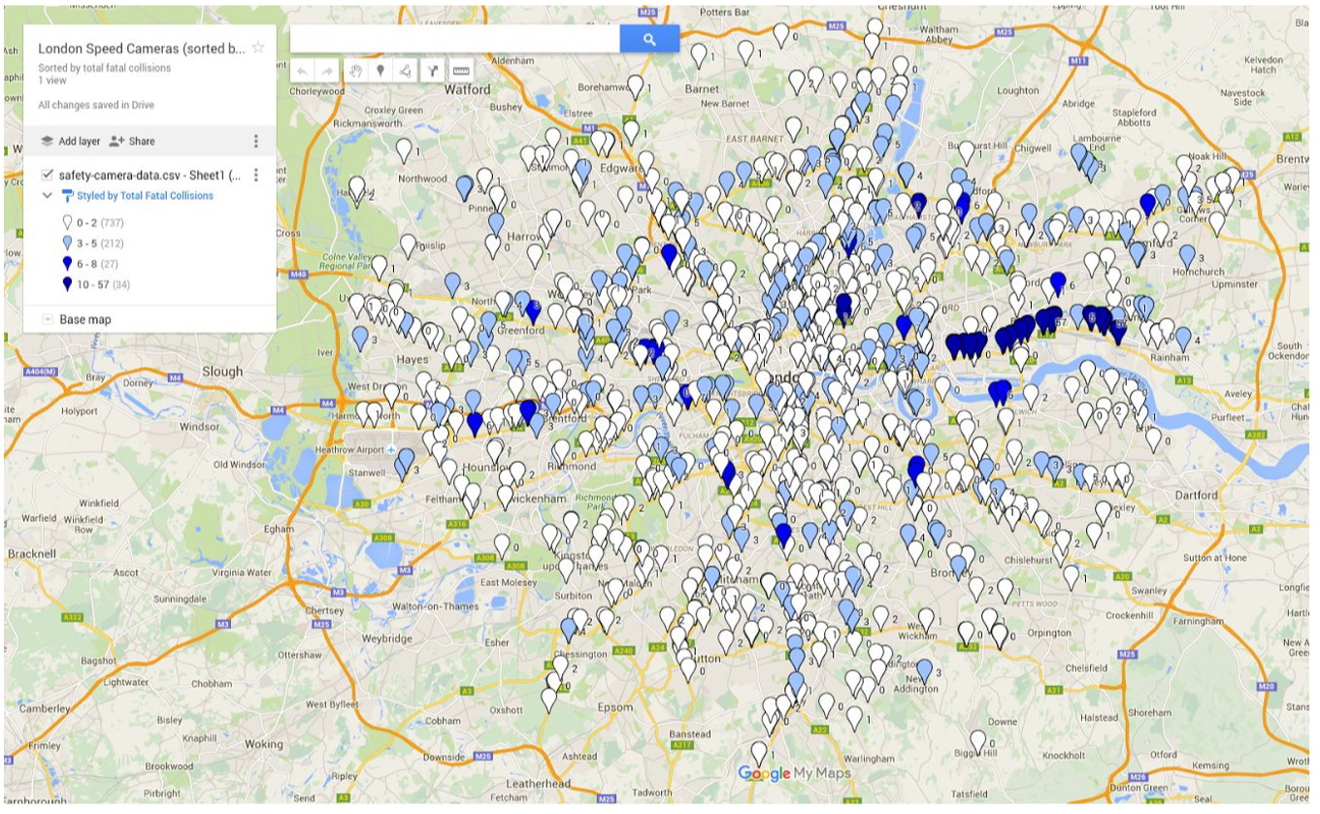
Speed Camera Investigation (Analysing)
How effective are speed cameras
Speed cameras sorted by number of fatal collisions

Slide 4
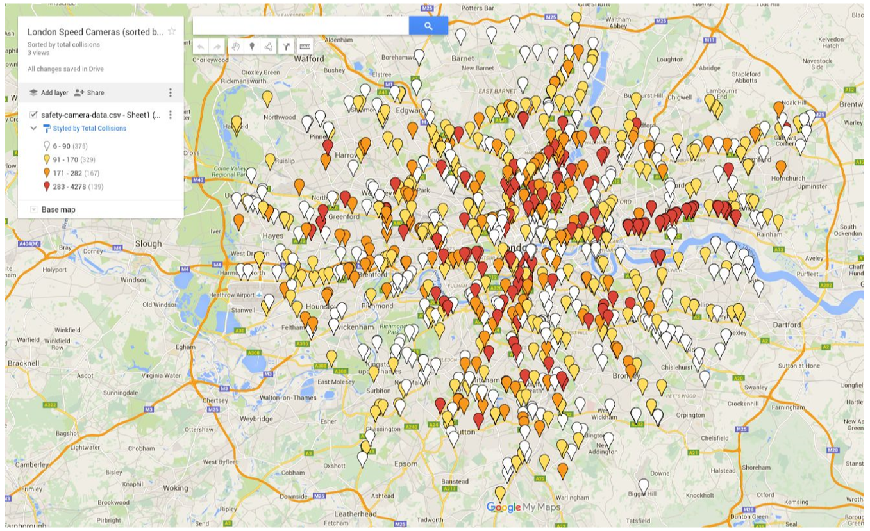
Speed Camera Investigation (Analysing)
How effective are speed cameras
Speed cameras sorted by total collisions

Slide 5
Speed Camera Investigation (Analysing)
How effective are speed cameras
Where do the most collisions occur?
Is there any sort of pattern?
Are there many fatal collisions in the centre of London? Why do you think that is?

Slide 6
Speed Camera Investigation (Analysing)
How effective are speed cameras
What conclusions can you
draw from these graphs?
Does this prove that speed
cameras make roads safer?

Slide 7
Speed Camera Investigation (Analysing)
How effective are speed cameras
Where do the most collisions occur?
Is there any sort of pattern?
Are there many fatal collisions in the centre of London? Why do you think that is?

